Slide 1
Data Structures and Algorithms -3 (25CS2103E)
Title of the project
Team Members
B. Chenna - 2520030546
S. Bheeshma - 2520030528
T. Abhinav-2520030075
Under the Esteemed Guidance of
Name of the DSA-3 faculty name with designation and department

Slide 2
Contents
Abstract
Introduction
Literature survey
Problem Statement and Objectives
Hardware and Software requirements
Results
Conclusion
Future Scope

Slide 3
Abstract
The SOS Dynamic Programming Based Subset Optimization and Query Engine is a computational tool designed to efficiently answer multiple subset-based queries on an integer set using Sum Over Subsets (SOS) Dynamic Programming. The system represents elements and subsets using bitmasks, with the input size restricted to n ≤ 20, and computes aggregate subset values efficiently in O(n × 2ⁿ) time. Users can enter an integer set and perform different subset-sum queries while the system displays the corresponding results. The application also compares the execution time of SOS DP with a brute-force approach to demonstrate its efficiency for large numbers of subset queries. A visualization module can represent subset relationships and algorithm performance through graphs and bitmask-based representations. The project demonstrates important concepts of dynamic programming, bitmasking, subset optimization, algorithm analysis, and performance evaluation in a practical application.

Slide 4
Introduction
Subset-based problems are an important class of computational problems that require finding or calculating values for different subsets of a given set. When the number of elements increases, checking every possible subset separately can become computationally expensive because a set of n elements has 2ⁿ possible subsets. The Sum Over Subsets (SOS) Dynamic Programming technique provides an efficient way to preprocess information about all subsets and answer multiple subset-based queries quickly.
This project develops an SOS Dynamic Programming Based Subset Optimization and Query Engine for integer sets with n ≤ 20. The system uses bitmask representation to identify subsets and applies SOS DP to calculate aggregate subset values in O(n × 2ⁿ) time. It also compares the performance of SOS DP with a brute-force approach, allowing users to observe the improvement in execution time. Through subset visualization and performance analysis, the project demonstrates how advanced dynamic programming techniques can solve large numbers of subset queries efficiently.

Slide 5
Literature Survey
S.no | Topic/ Techinque | Key Findings | Relevance
1 | Dynamic Programming | DP solves problems by storing results of overlapping subproblems and avoiding repeated computation. | Provides the foundation for SOS DP.
2 | Bitmasking | Represents subsets using binary numbers, allowing efficient subset manipulation. | Used to represent all subsets of the integer set.
3 | Subset Sum Problem | Traditional approaches enumerate possible subsets, which becomes expensive as the input size increases. | Motivates the need for optimization
4 | Sum Over Subsets (SOS) DP | Computes aggregate values over all submasks efficiently in O(n × 2ⁿ) time. | Core algorithm used in the proposed system.
5 | Performance Visualization | Graphs and execution-time measurements help demonstrate algorithmic efficiency. | Used to compare SOS DP with brute force.

Slide 6
Problem Statement and Objectives
Problem Statement
Traditional brute-force methods for solving multiple subset-sum queries become inefficient as the number of elements increases because they repeatedly examine a large number of subsets. This project develops a Subset Optimization Tool using Sum Over Subsets (SOS) Dynamic Programming to efficiently compute subset aggregate values for an integer set with n ≤ 20. The system also provides query processing, subset visualization, and performance comparison between SOS DP and brute-force methods.
Objectives
Develop an SOS Dynamic Programming-based subset optimization tool.
Compute subset sums efficiently for all possible bitmasks.
Answer multiple subset queries using precomputed SOS DP values.
Reduce execution time compared with brute-force subset enumeration.
Visualize subset relationships and bitmask representations.
Compare performance of SOS DP and brute-force approaches.
Demonstrate scalability for integer sets with up to 20 elements.

Slide 7
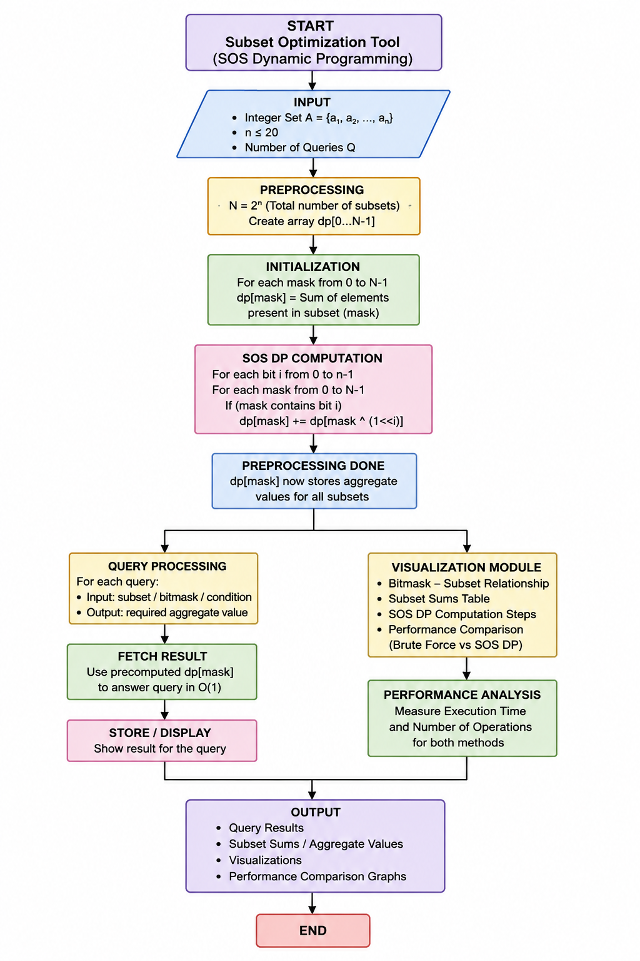
Flow Chart

Slide 8
Results
Successfully developed a Subset Optimization Tool using SOS Dynamic Programming.
Computes subset sums efficiently for n ≤ 20 (up to 2²⁰ subsets).
Answers multiple subset-based queries with improved performance.
SOS DP: O(n × 2ⁿ) preprocessing compared with slower brute-force approaches.
Visualizes bitmask–subset relationships and subset sums.
Performance comparison demonstrates the efficiency and scalability of SOS DP.

Slide 9
Hardware and Software requirements
HARDWARE | SOFTWARE
Intel Core i3 or equivalent and above | HTML, CSS, JavaScript (if using a web interface)
Minimum 4 GB | Windows 10/11, Linux, or macOS
At least 500 MB free space
Standard monitor/laptop display
Optional, for development tools and libraries | Sum Over Subsets (SOS) Dynamic Programming

Slide 10
Conclusion
The SOS Dynamic Programming Based Subset Optimization and Query Engine demonstrates how dynamic programming and bitmasking can efficiently solve multiple subset-based queries. By using SOS DP, the system computes aggregate subset values in O(n × 2ⁿ) time, providing better performance than repeatedly checking subsets using brute force. The performance comparison and visualization help demonstrate the practical advantages of the algorithm. Overall, the project provides a simple and effective implementation of advanced dynamic programming concepts and can be further extended to support more complex subset queries and larger-scale optimization problems.

Slide 11
Future Scope
Support larger input sizes beyond n ≤ 20 using advanced optimization techniques.
Add more query types such as subset maximum, minimum, XOR, AND, and frequency queries.
Improve visualization with interactive bitmask and subset relationship graphs.
Add parallel processing to speed up SOS DP computation for large datasets.
Develop a web-based interface for easier interaction and visualization.
Compare more algorithms such as Meet-in-the-Middle and other subset optimization techniques.
Use real-world applications such as resource allocation, scheduling, feature selection, and combinatorial optimization.
Provide real-time performance analysis for different input sizes and query counts.

Slide 12
Thank you

